Slide 1


Slide 2

01.
Background
02.
Problem Statements
03.
Data Preparation
04.
Modeling
05.
Summary

Slide 3

01
Background

Slide 4


Slide 5
02
Objective and
Problem Statements

Slide 6
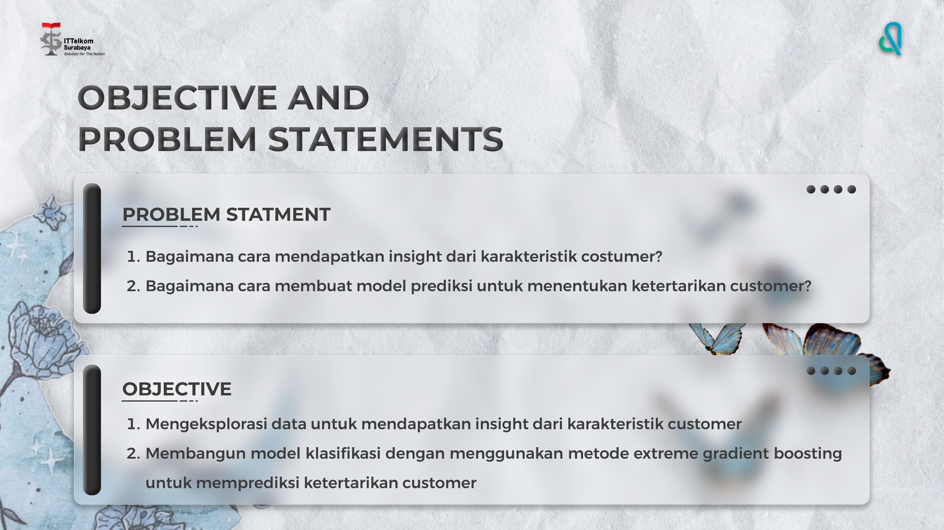

Slide 7
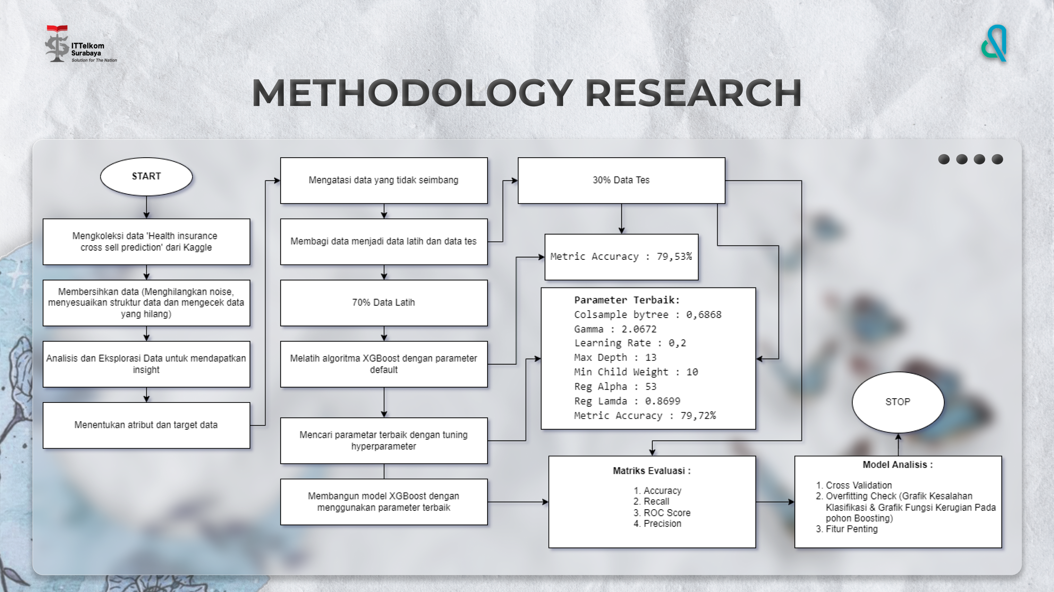

Slide 8
03
Data Preparation
(EDA & Feature Engineering)

Slide 9
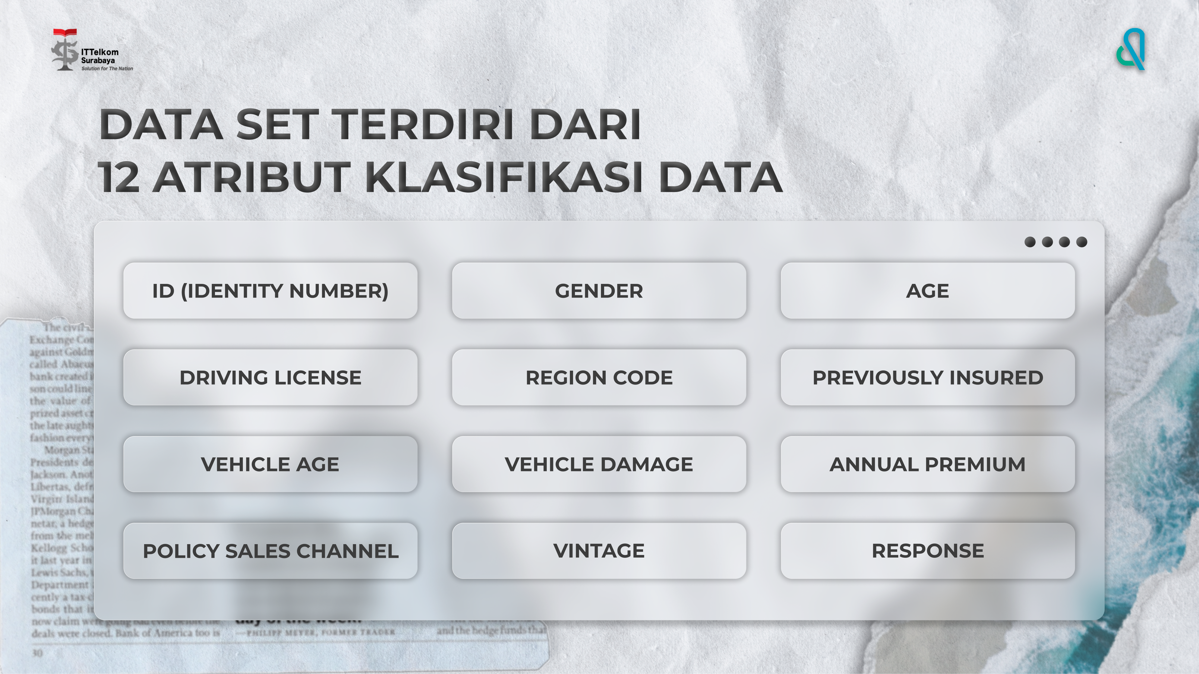

Slide 10
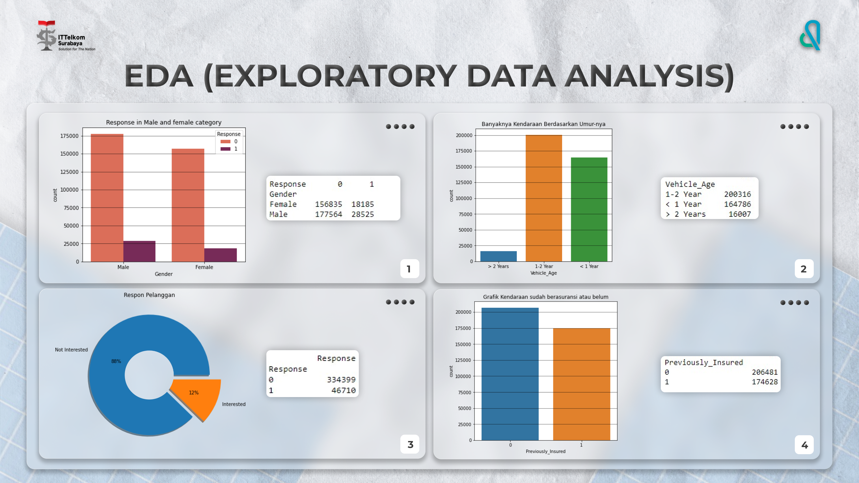

Slide 11
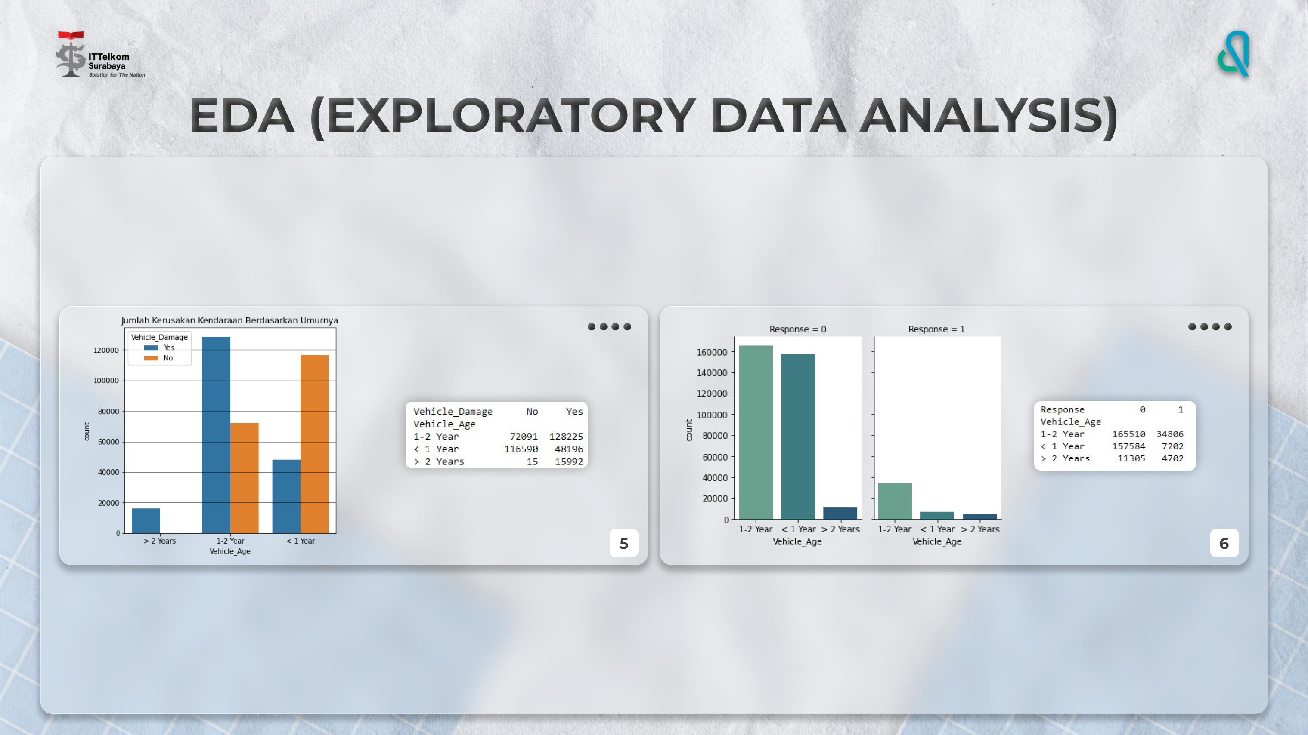

Slide 12
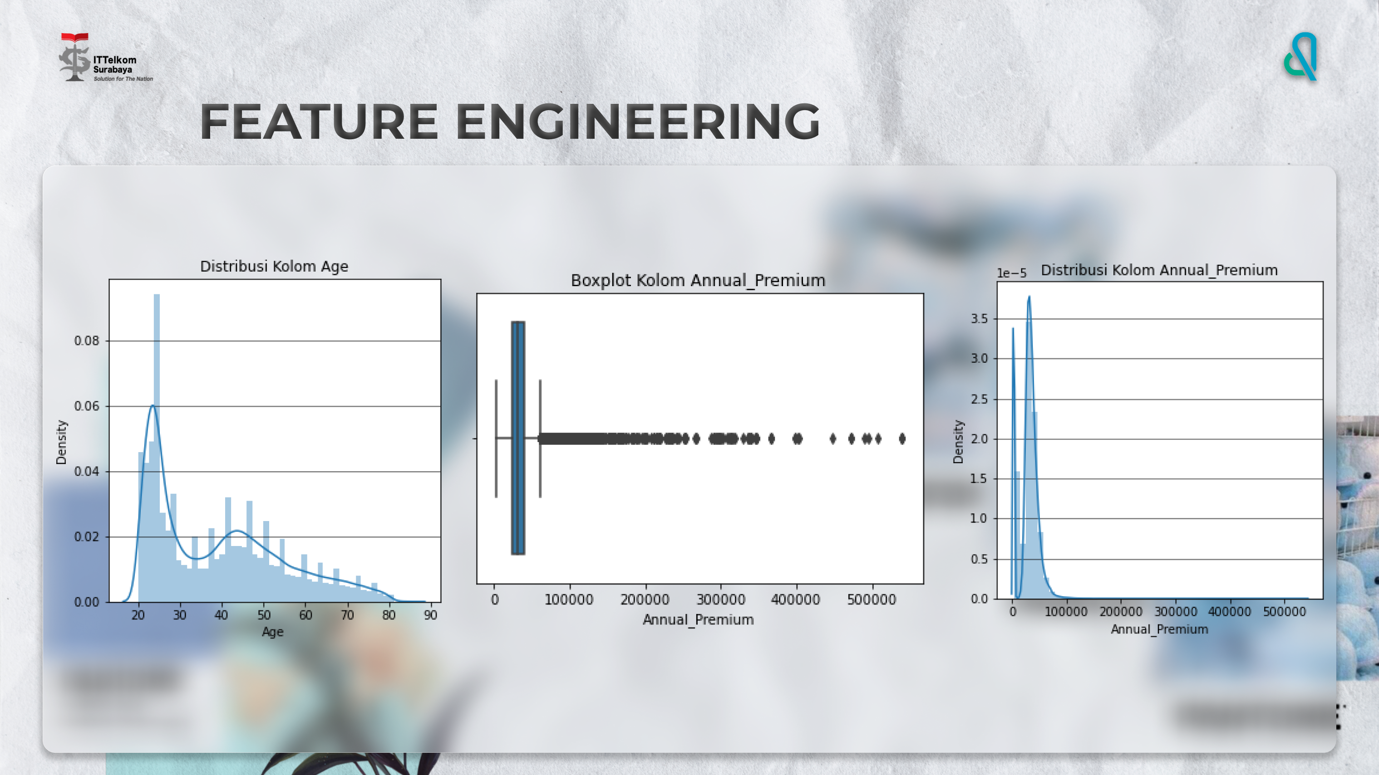

Slide 13
04
Modeling

Slide 14
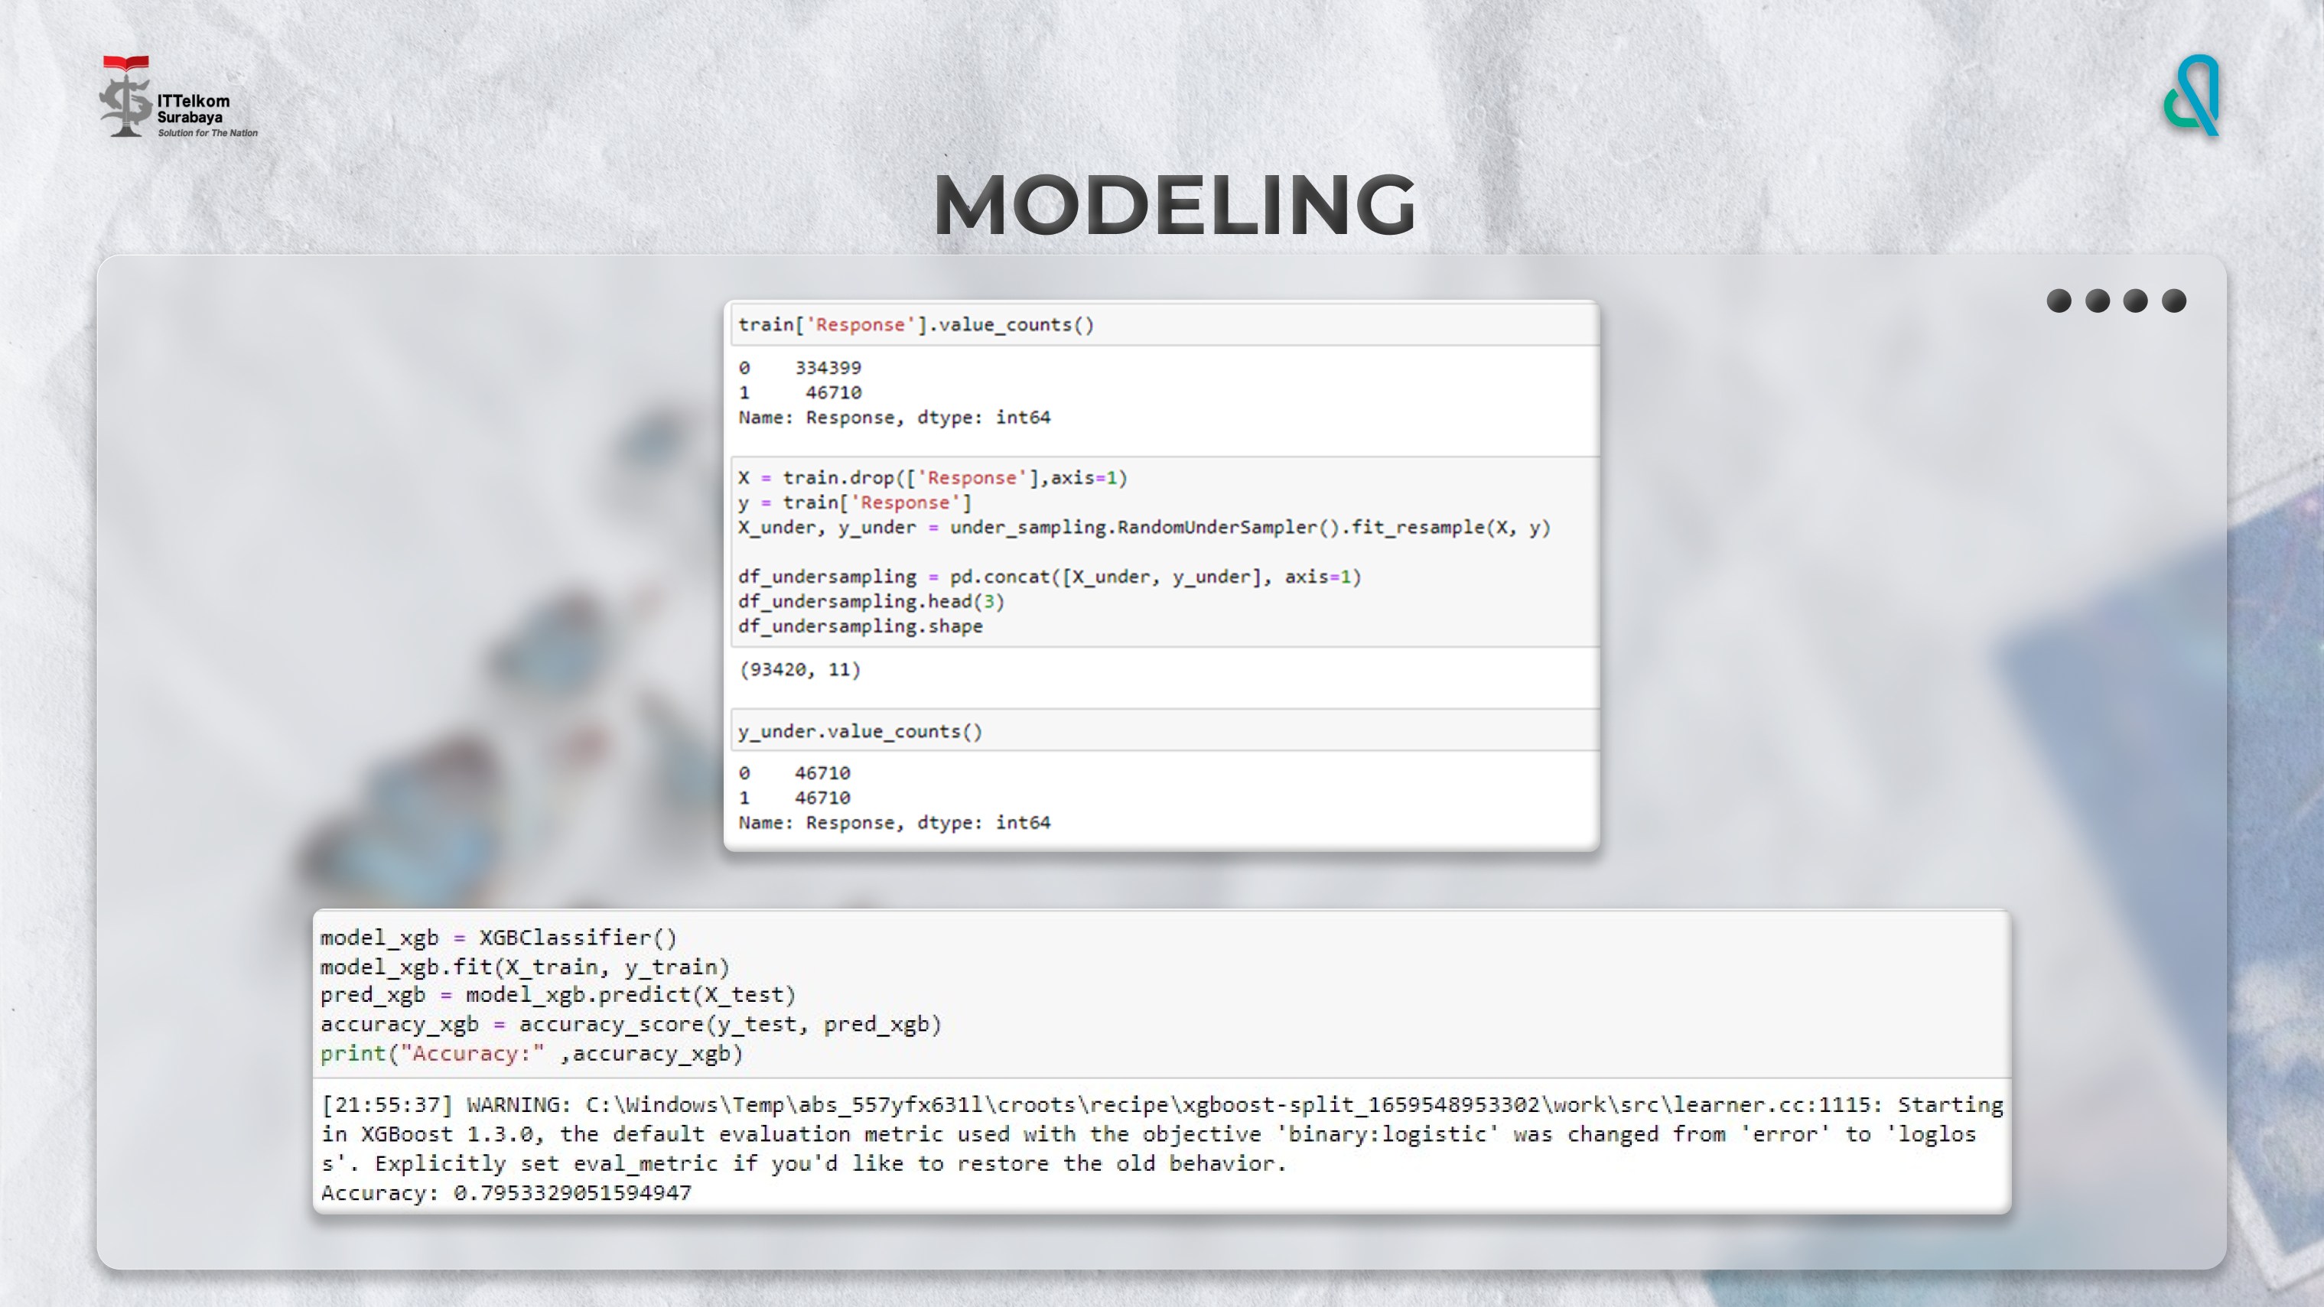

Slide 15
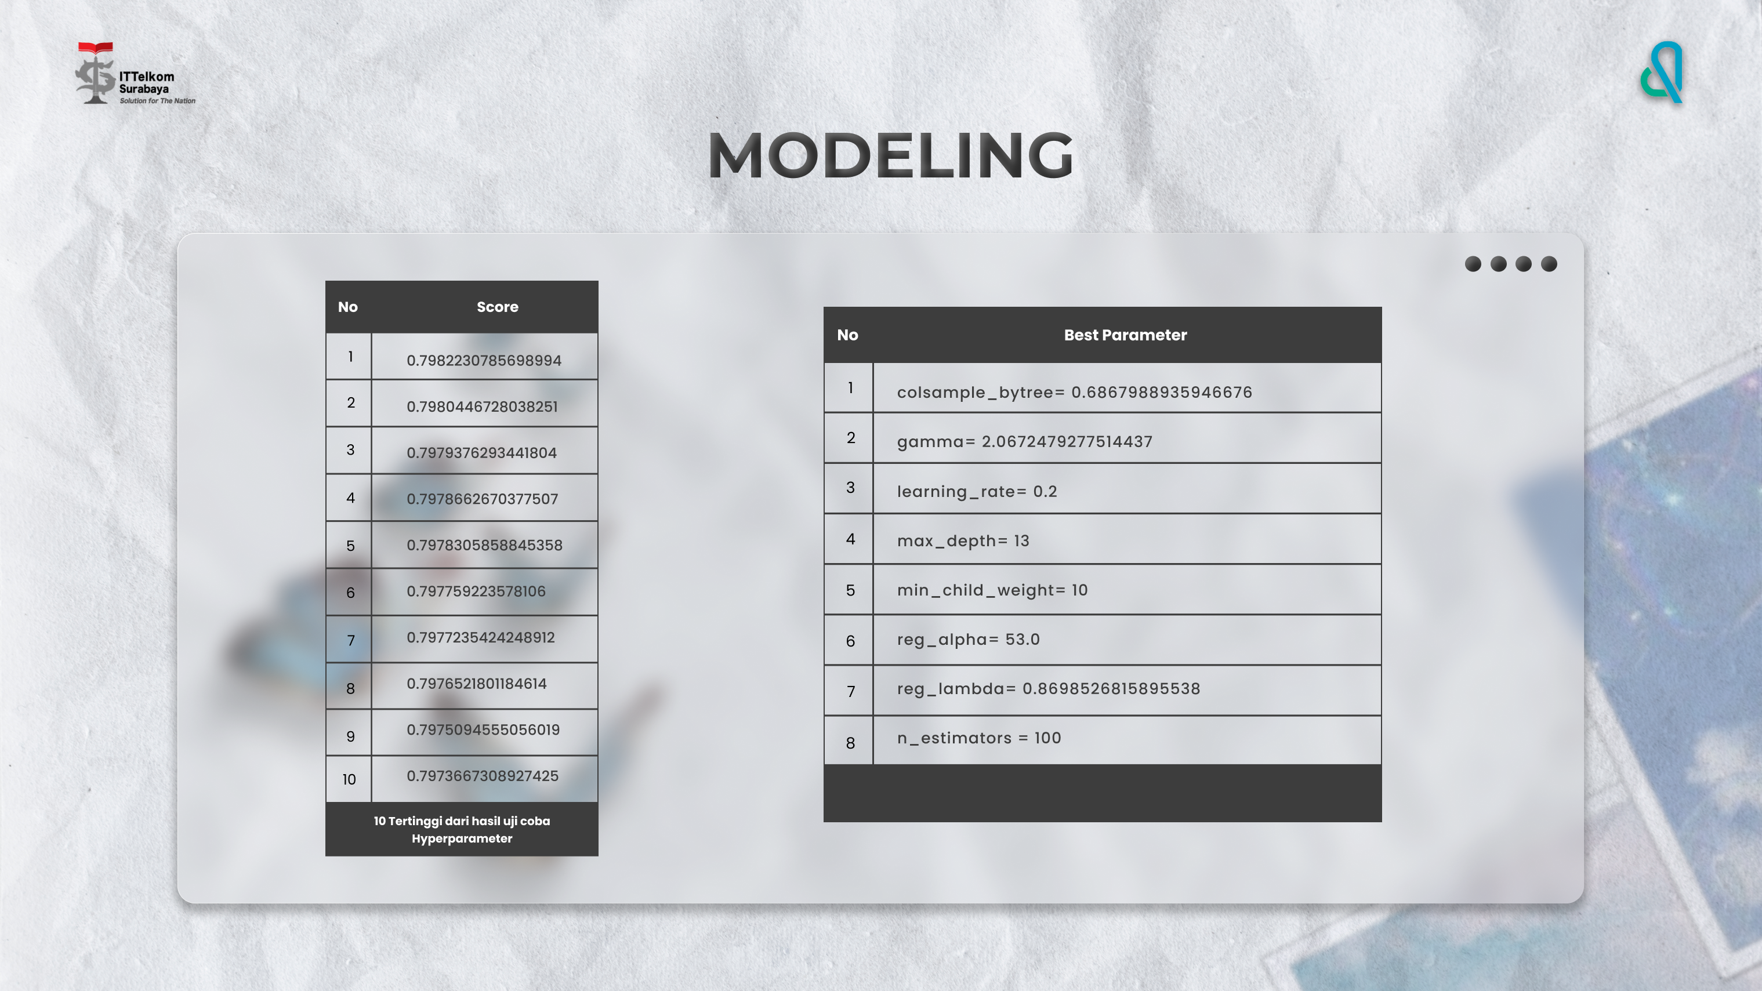

Slide 16
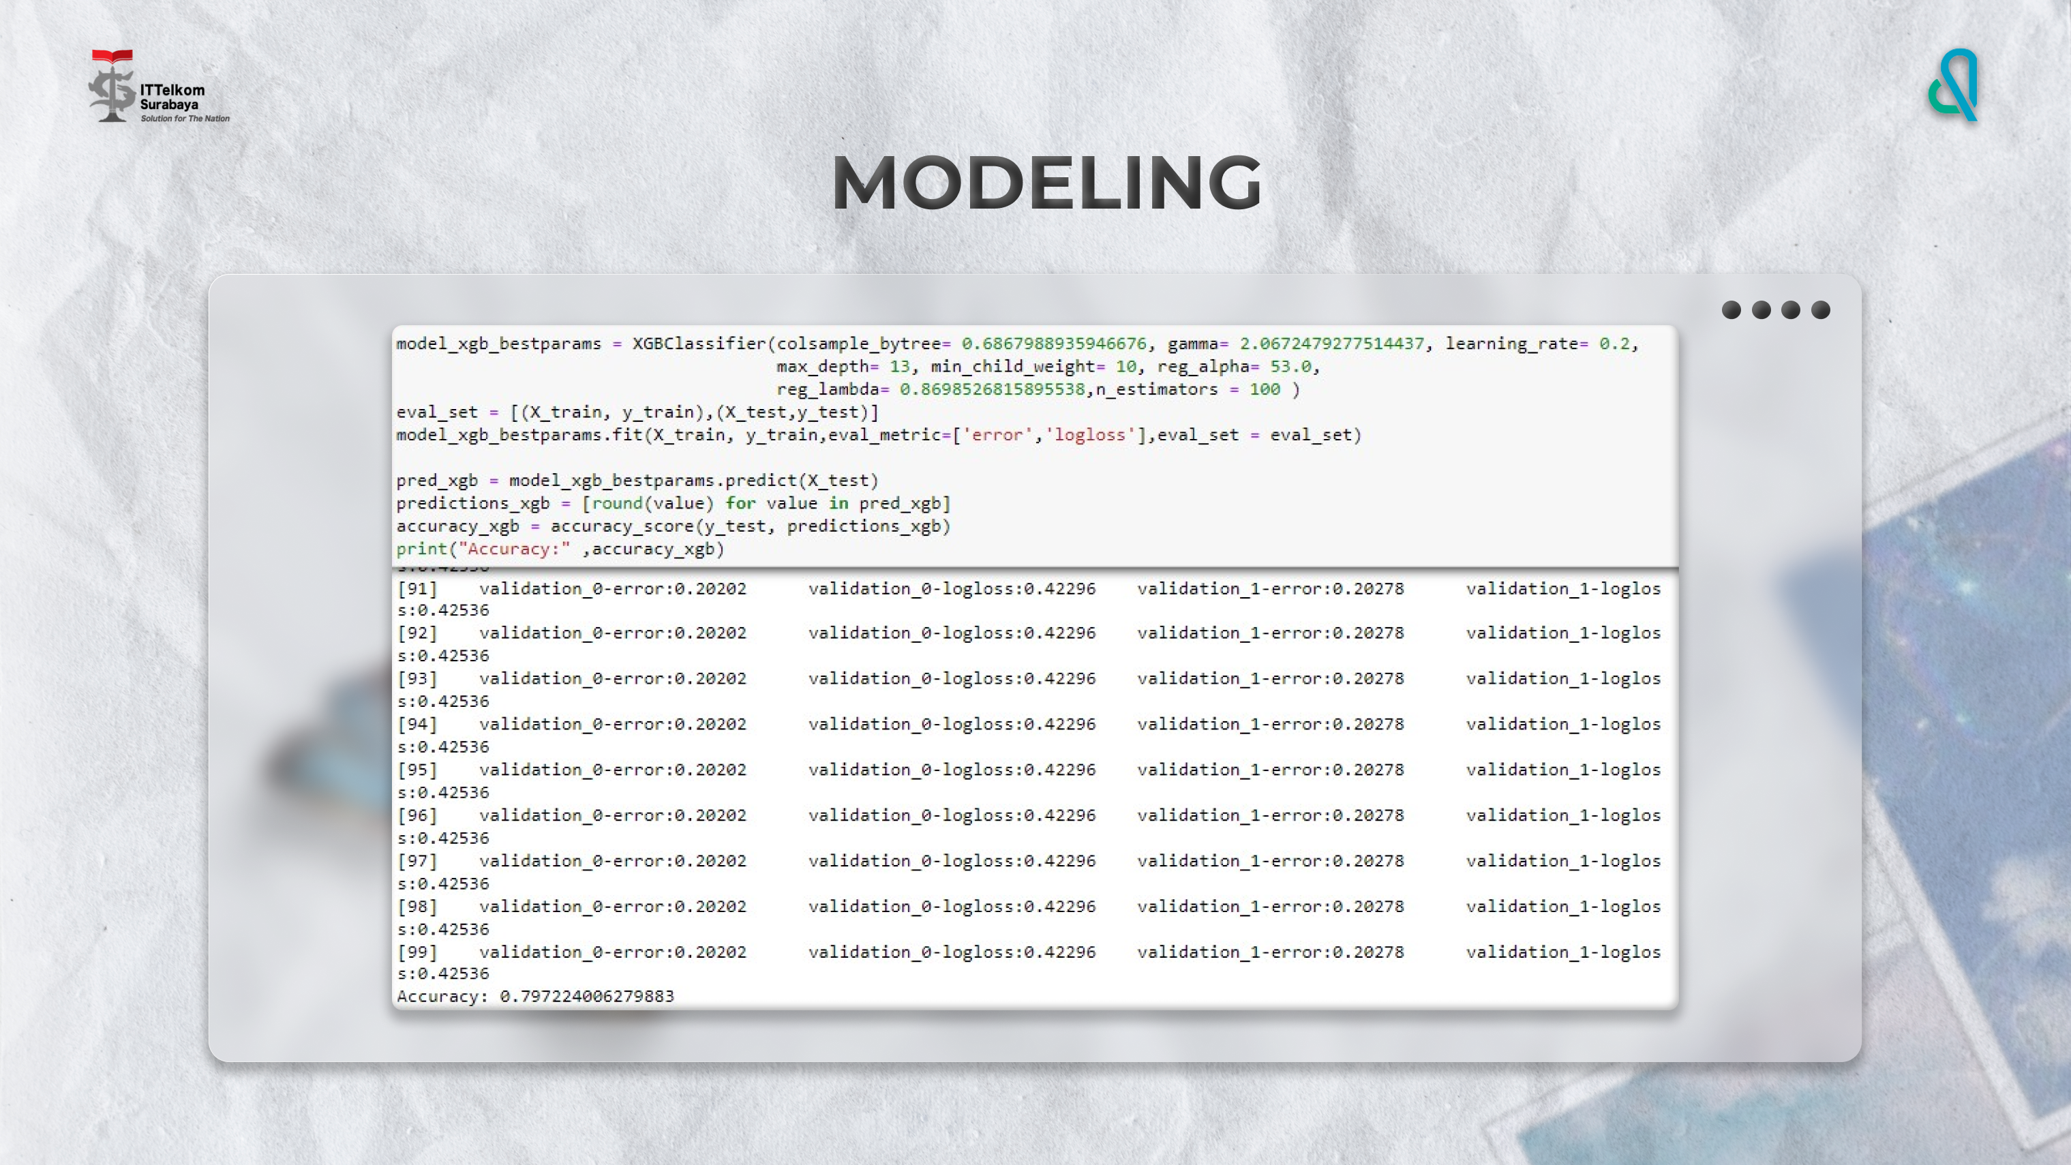

Slide 17
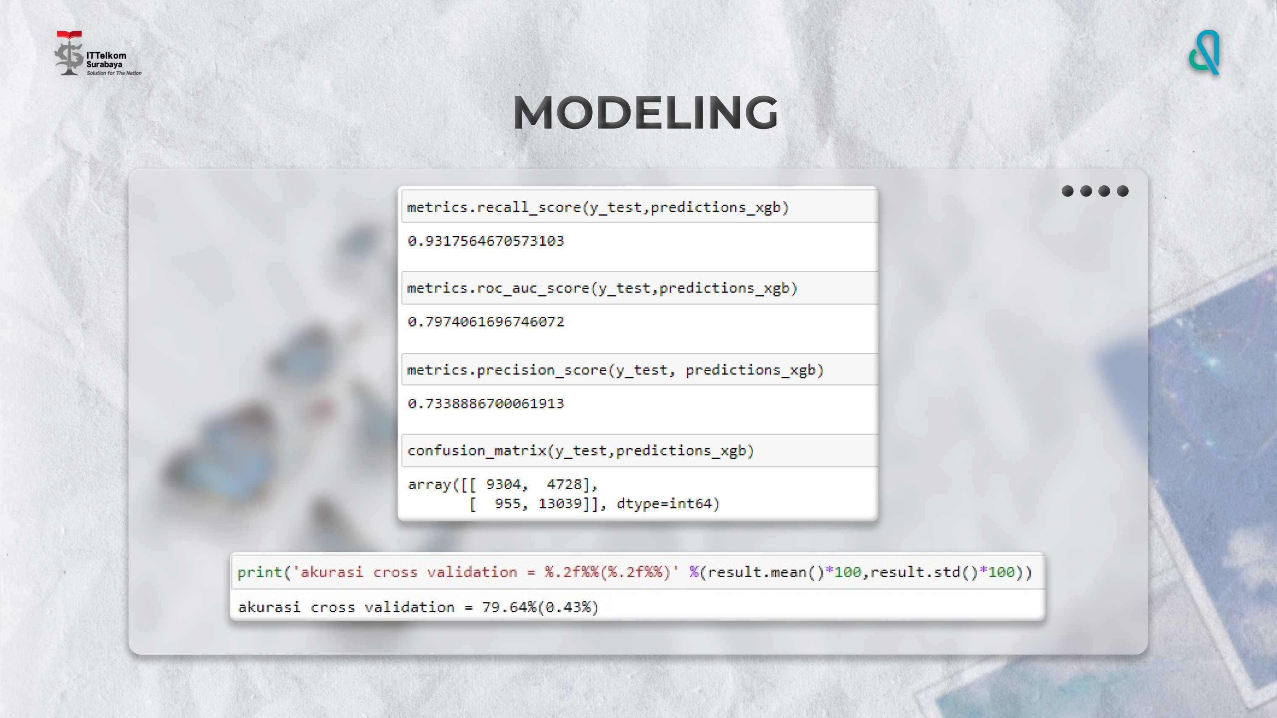

Slide 18
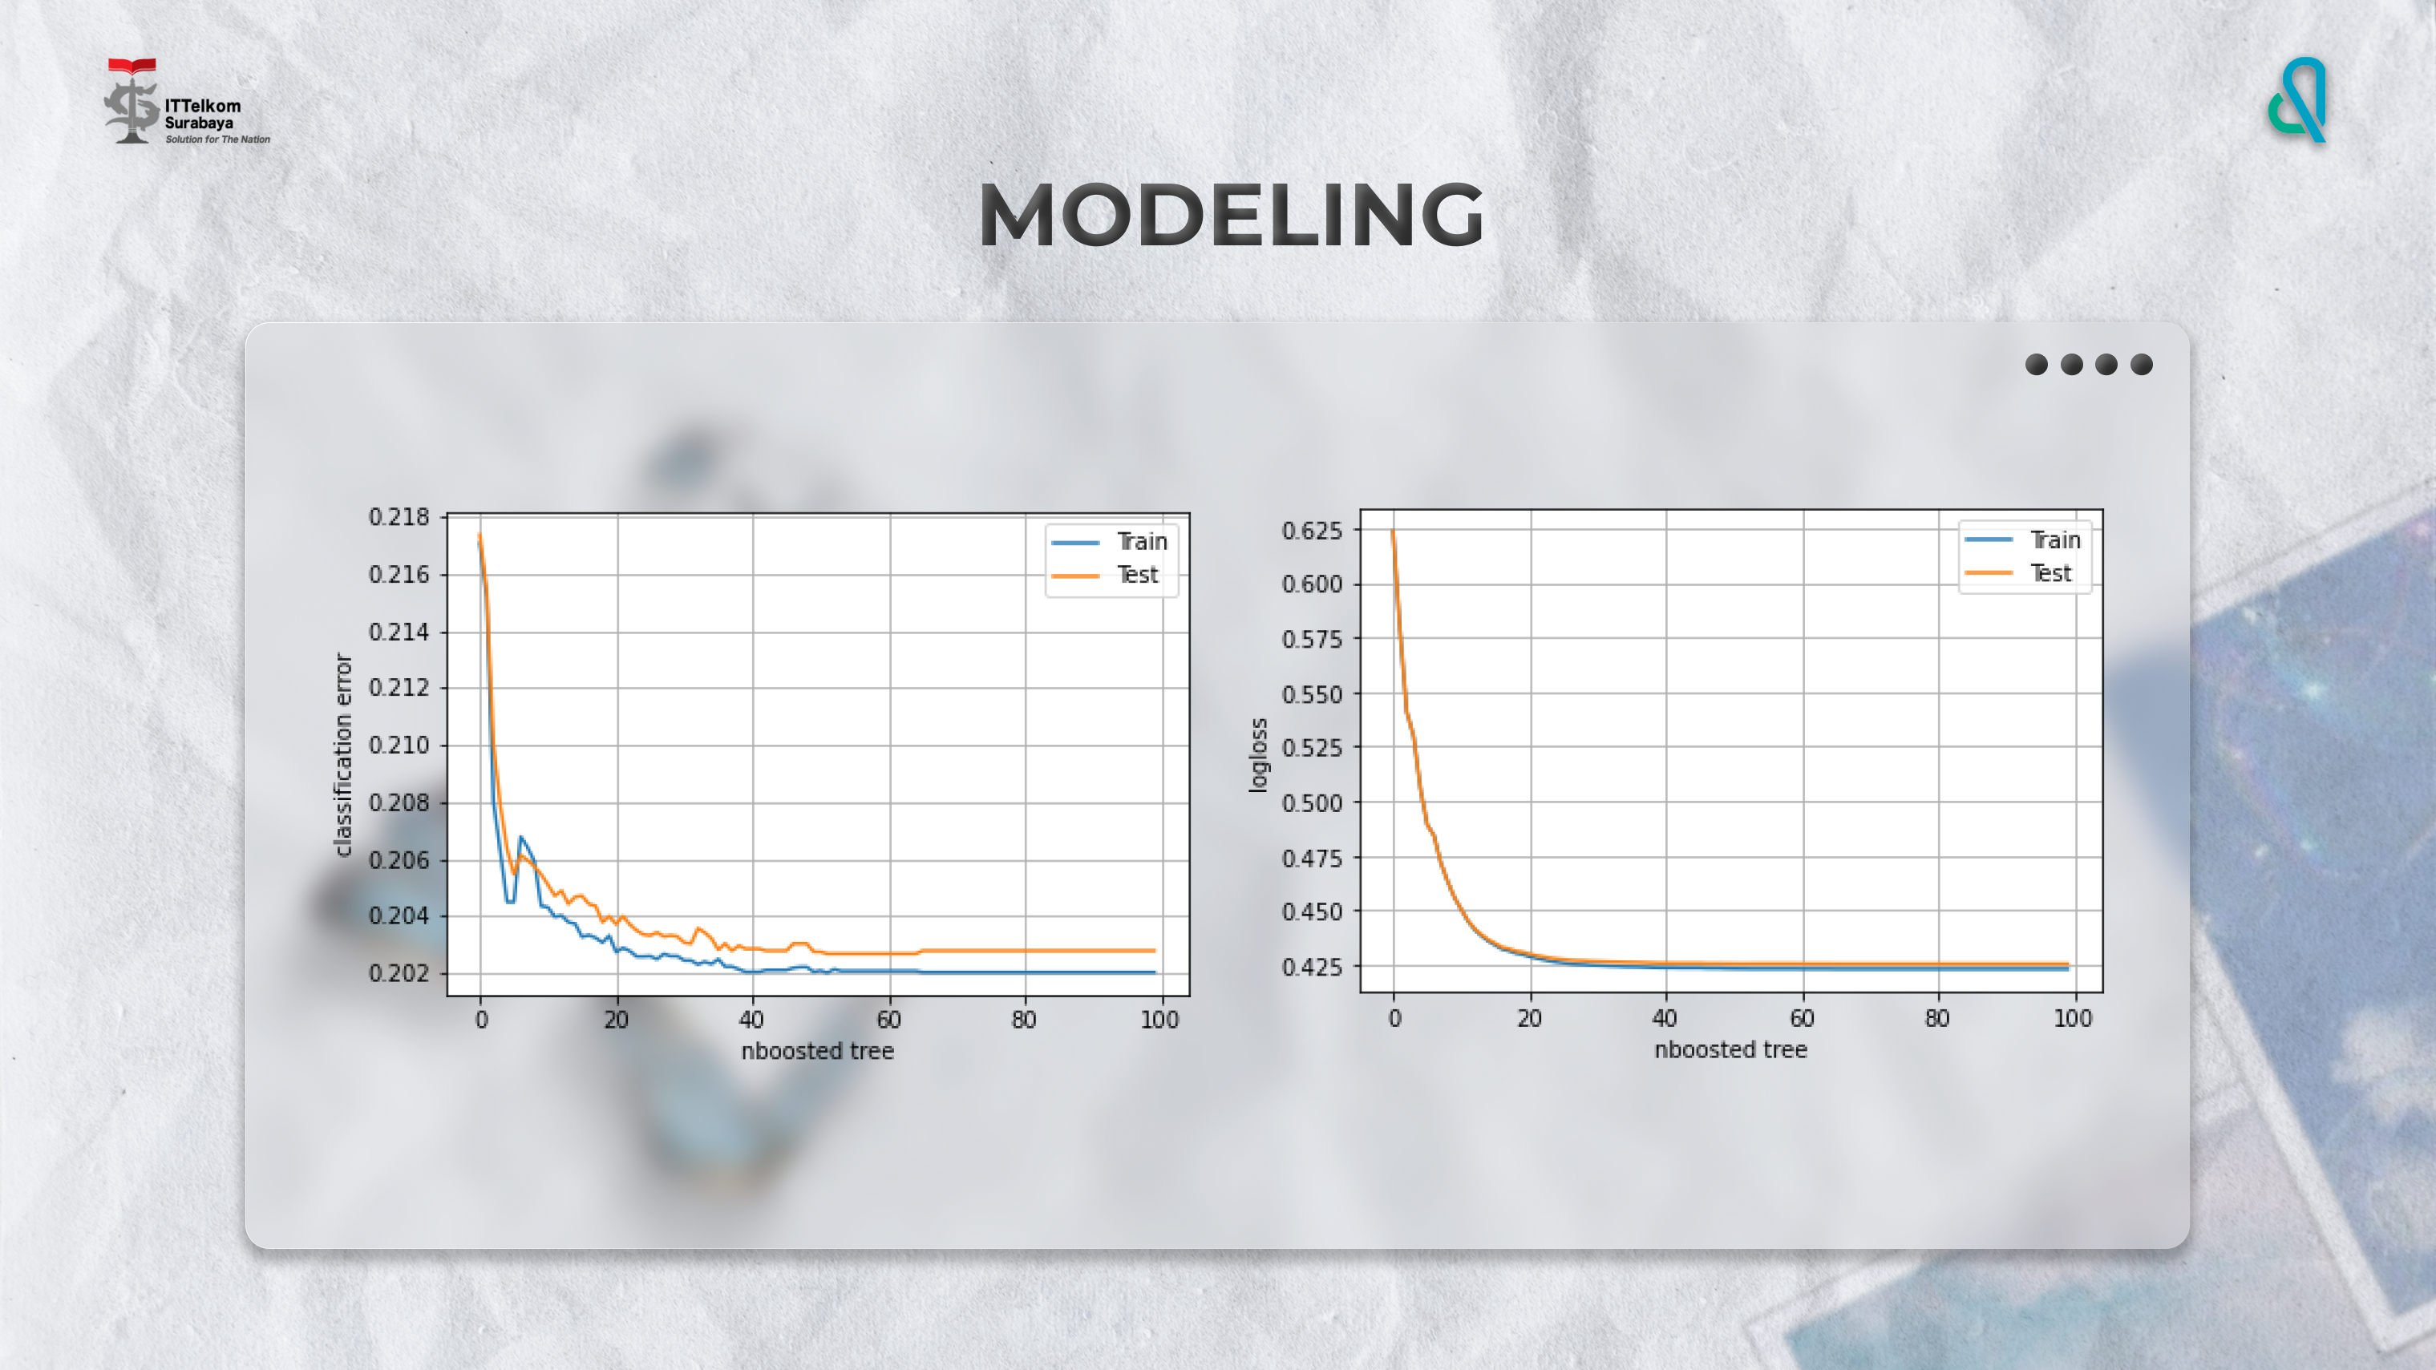

Slide 19
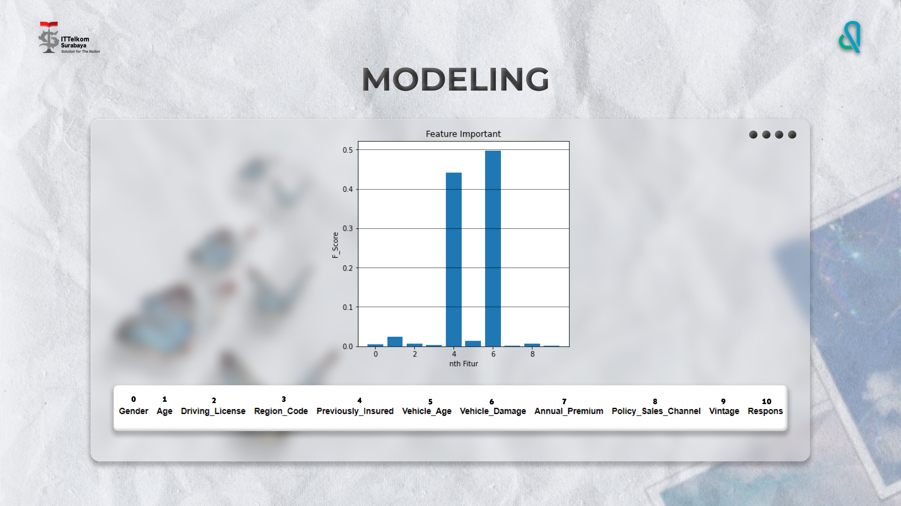

Slide 20
05
Summary

Slide 21
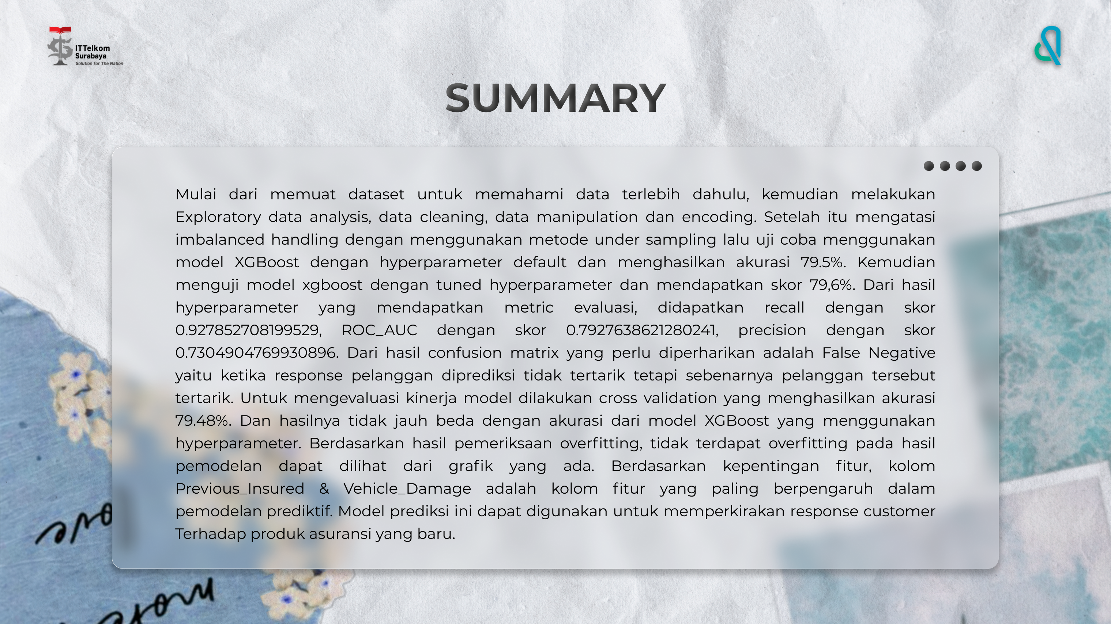

Slide 22


